Slide 1
Ventricles of the brain
Objectives
To learn the-
location, boundaries, contents and functions of brain ventricles.
locations, the origins, the fate and functions of the cerebrospinal fluid.
To understand the-
structure and function of the blood-brain barrier and blood-CSF barriers.
clinical implications of CSF.

Slide 2
What are the Ventricles?
Communicating cavity within the C N S that are lined by ependymal cells, which produces, contains and circulates C S F.

Slide 3
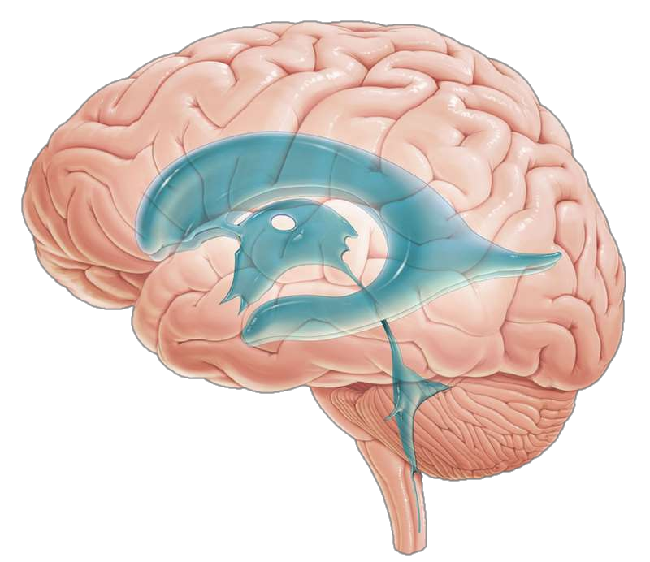

Slide 4
How many cavities?

Slide 5
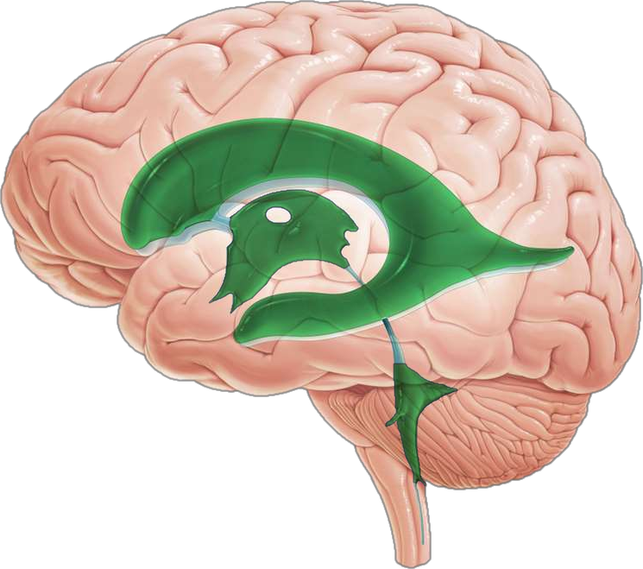

Slide 6
The ventricular system comprises
Two lateral ventricles
Single 3rd Ventricle
Single 4th Ventricle and
Single Terminal Ventricle
All of these are connected in series via channels.

Slide 7


Slide 8
These channels are
Interventricular foramen or foramen of Monro
The cerebral aqueduct
Central canal

Slide 9
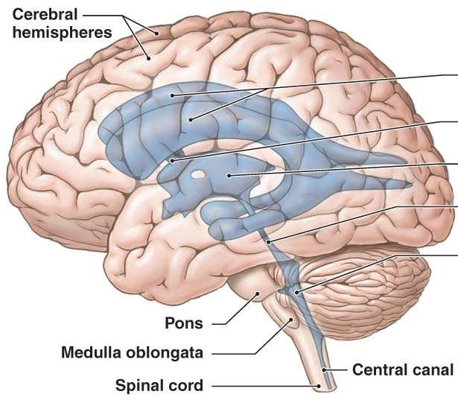
Lateral ventricle
Interventricular foramen
Third ventricle
Cerebral aqueduct
Fourth ventricle

Slide 10
Ventricles

Slide 11
Lateral Ventricles

Slide 12
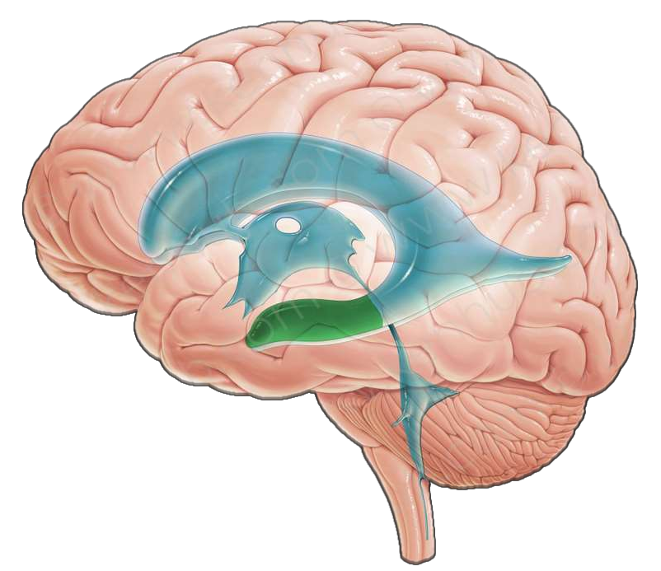
Lateral Ventricle

Slide 13
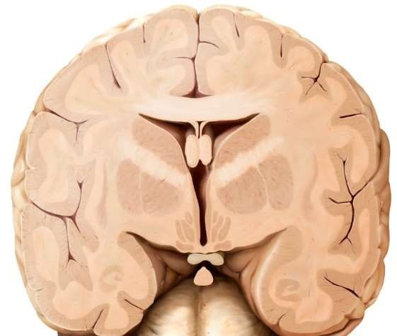
Body

Slide 14
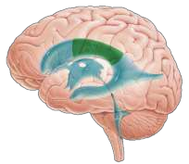
Body
Lies in the parietal lobe.
Roof: Corpus callosum (Trunk).
Floor: Sloping, From lateral to medial it is formed by, Body of caudate nucleus, Upper surface of thalamus, Choroid plexus, Body of fornix.
Medial wall: Septum pellucidum.
Lateral wall: Narrow area at the meeting of roof & floor.

Slide 15
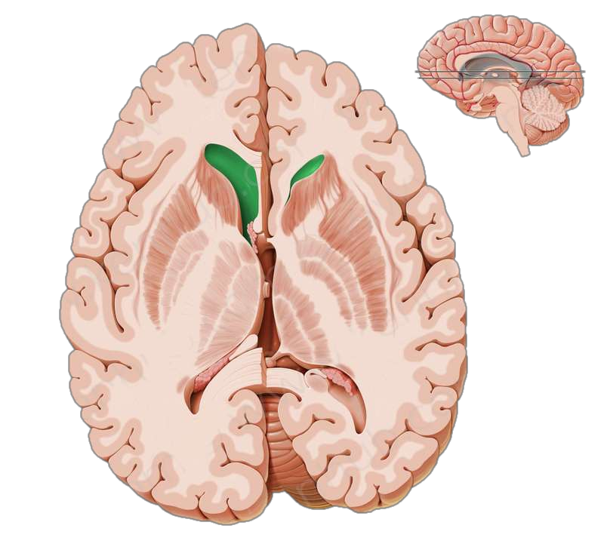
Anterior Horn

Slide 16
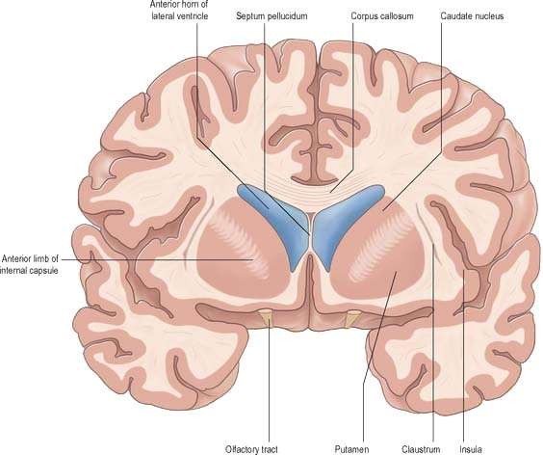
Anterior Horn

Slide 17
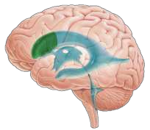
Anterior Horn
Location: In the frontal lobe.
Roof: Corpus callosum (trunk)
Floor: Corpus callosum (Rostrum), Caudate nucleus head
Anterior: Corpus callosum (Genu)
Medially: Septum pellucidum.

Slide 18
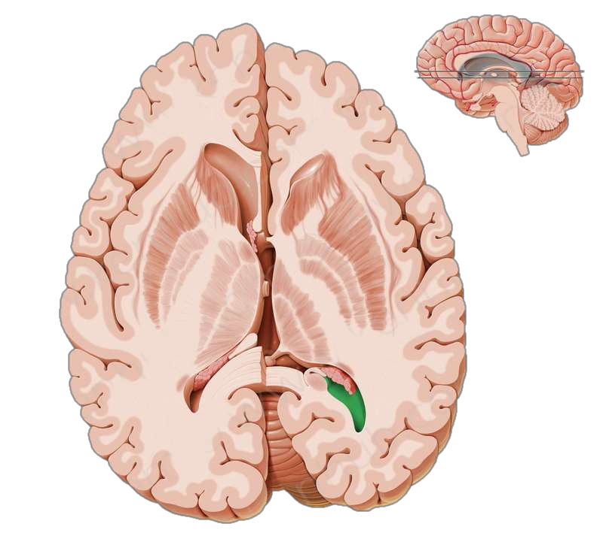
Posterior Horn

Slide 19
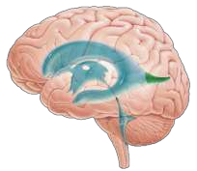
Posterior Horn
Location: In the occipital lobe.
Roof, lateral wall: Formed by the Tapetum of the corpus callosum.
Medially: There are 2 elevations; Bulb of posterior horn (formed by forceps major) and Calcar avis, produced by calcarine sulcus.

Slide 20
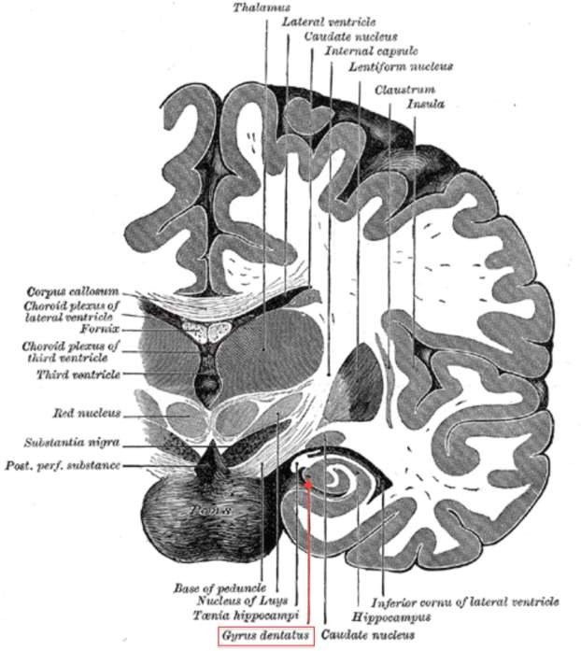

Slide 21
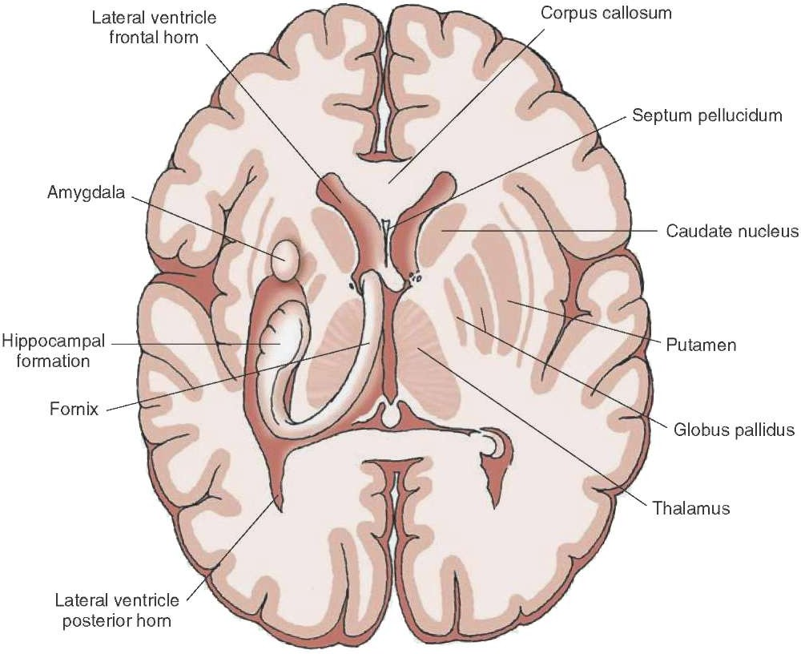
Inferior Horn

Slide 22
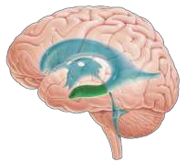
Inferior Horn
Location: It lies in the temporal lobe.
Roof: Tapetum, Tail of caudate nucleus, Amygdaloid nucleus, Stria terminalis.
Floor: Hippocampus, Fimbria of hippocampus & Collateral eminence.

Slide 23
Third Ventricle

Slide 24
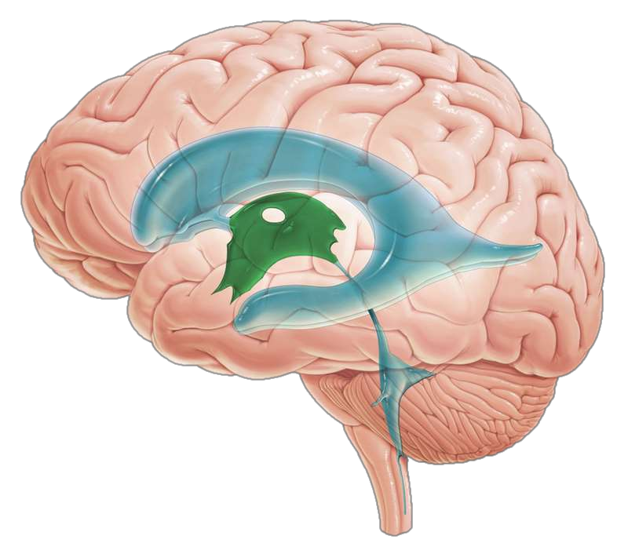

Slide 25
Location: Between two thalamus

Slide 27
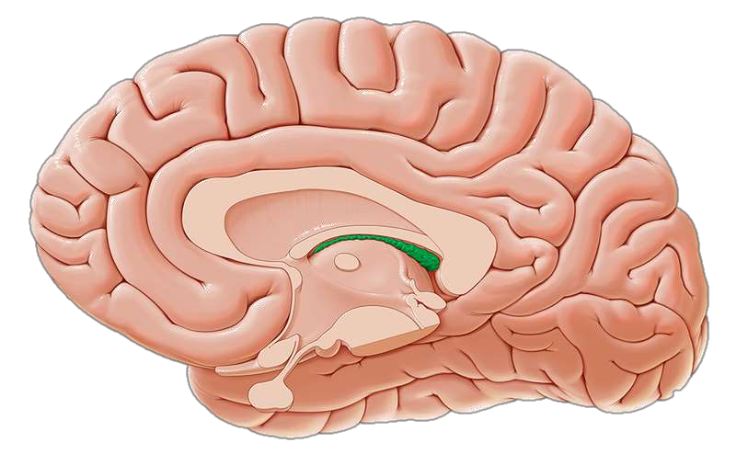

Slide 28
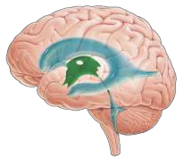
Roof: Fornix, tella choroida
Floor: Hypothalamus
Laterally: Thalamus, hypothalamus
Anteriorly: lamina terminalis
Posteriorly: opening into the cerebral aqueduct, posterior commissure, pineal recess, habenular commissure

Slide 29
Fourth Ventricle

Slide 30


Slide 31
Location: Anterior to the cerebellum and posterior to the pons and the superior half of the medulla oblongata

Slide 32
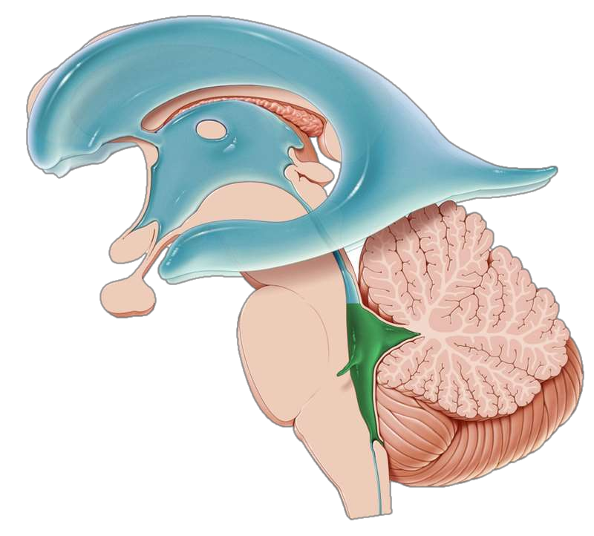

Slide 33

Floor: Posterior surface of the pons and the cranial half of the medulla oblongata
Laterally: Inferior cerebellar peduncle and superior cerebellar peduncle
Roof: The tent-shaped roof projects into the cerebellum

Slide 34
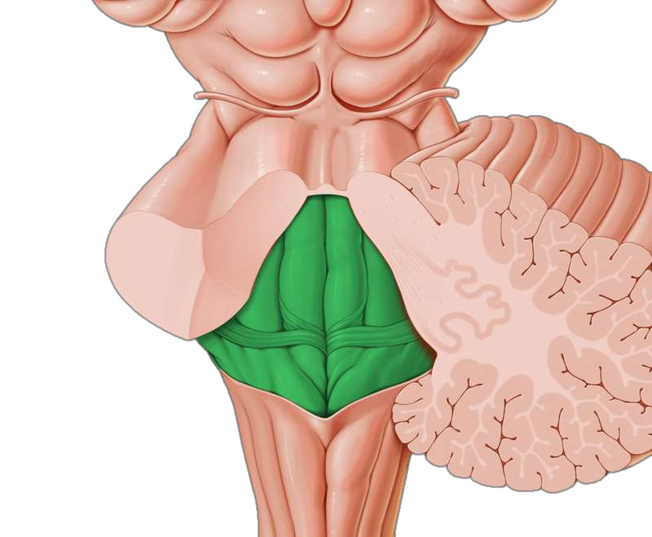

Slide 35
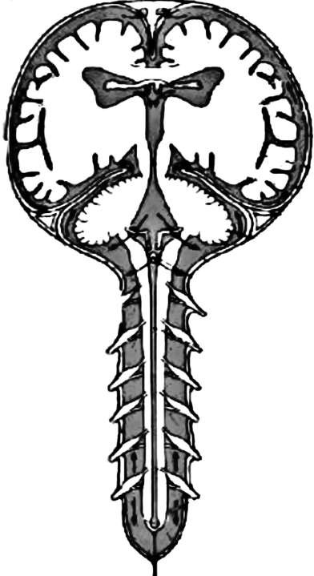
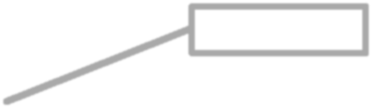
Terminal ventricle

Slide 36
What are the function of ventricles?

Slide 37
CSF
Clear, water-like fluid resides within the ventricular system.

Slide 38
Appearance and composition
Appearance Clear and colorless
Volume 150 mL
Rate of production 0.5 mL/minute
Pressure (spinal tap with patient in 60-150 mm of water lateral recumbent position)
Composition
Protein 15-45 mg/100 mL
Glucose 50-85 mg/100 mL
Chloride 720-750 mg/100 mL
Number of cells 0-3 lymphocytes/cumm

Slide 39
How CSF is formed?

Slide 40
Choroid Plexus
It is a vascular fringe composed of pia mater covered with the ependymal lining of the ventricular cavity.

Slide 41


Slide 42
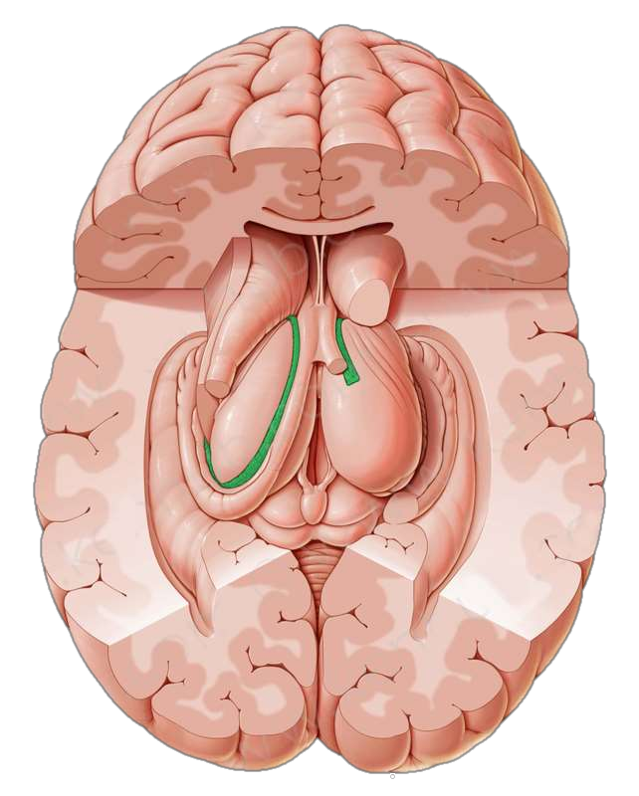

Slide 43
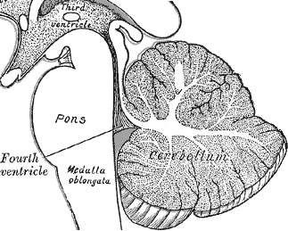

Slide 44
Circulation of CSF

Slide 45
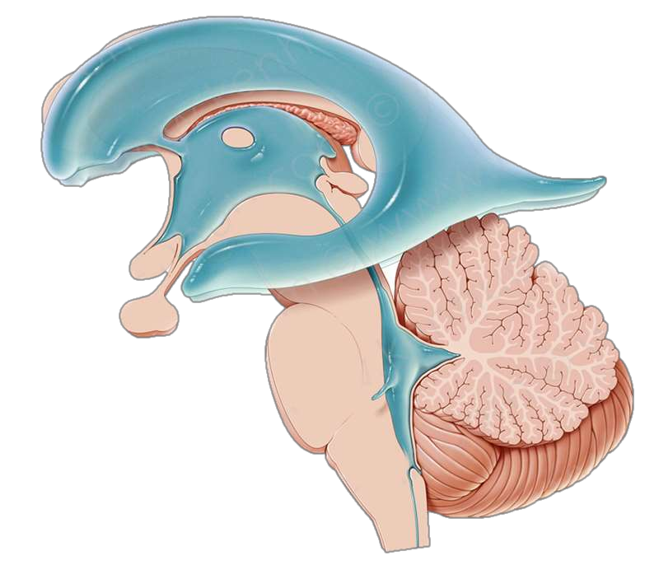
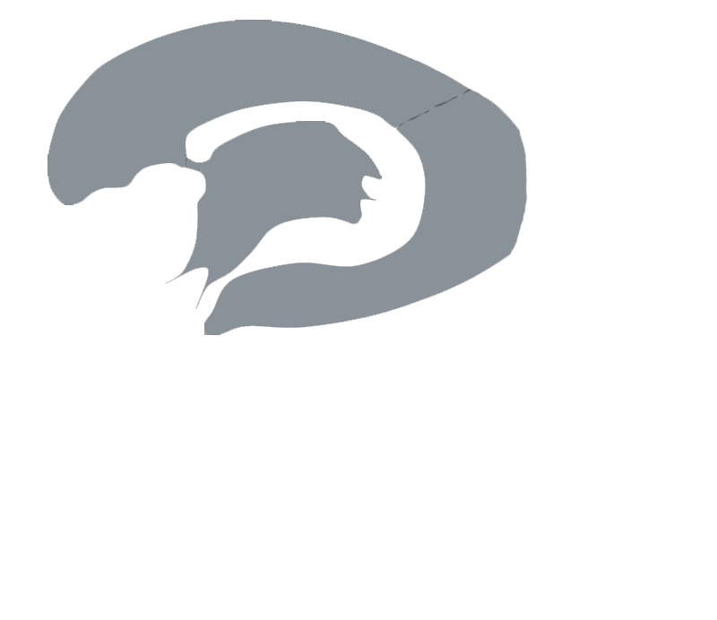



Slide 46
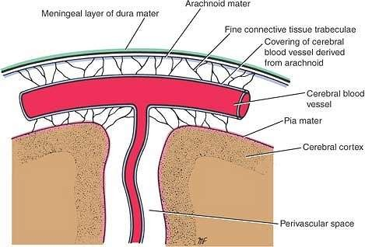

Slide 47
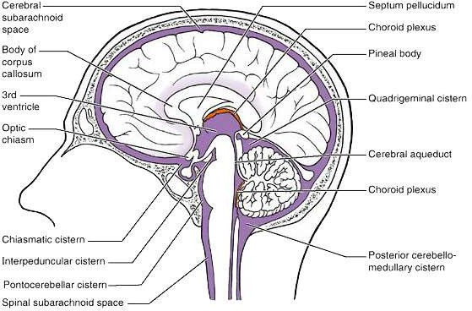

Slide 48

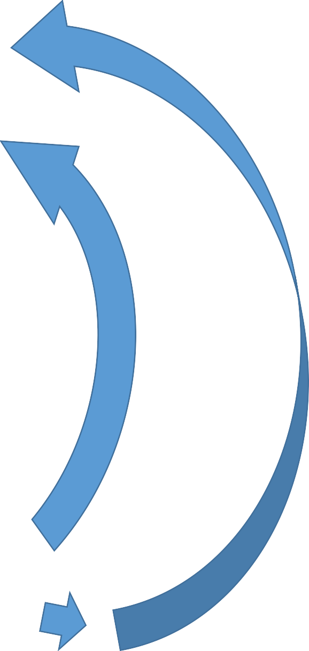

Slide 49
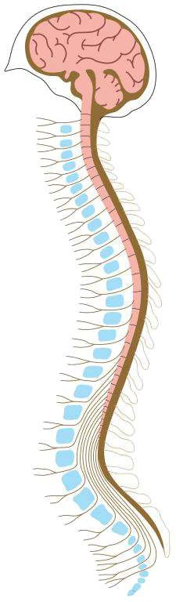
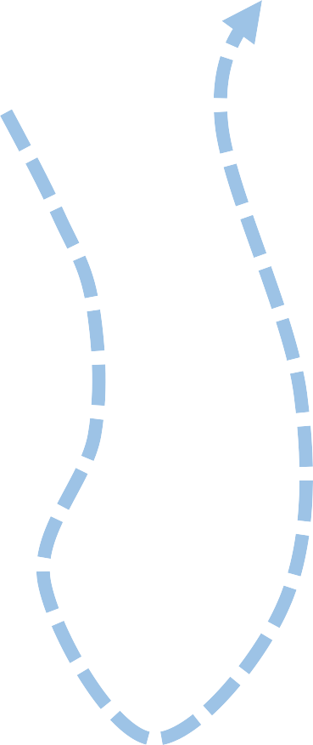

Slide 50
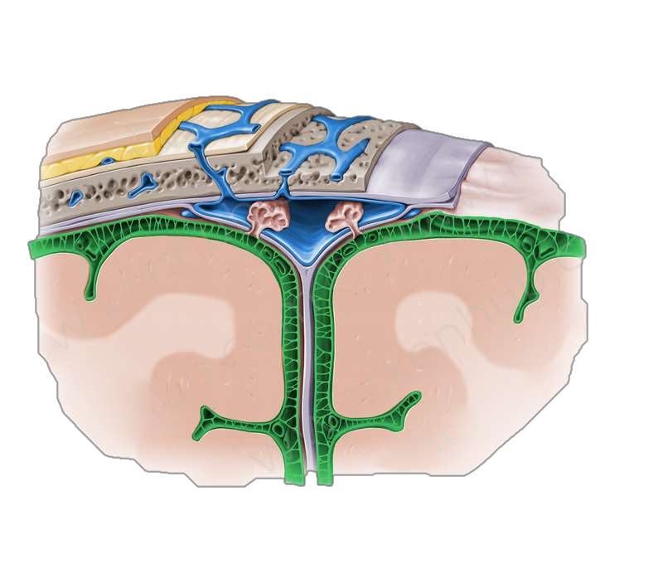
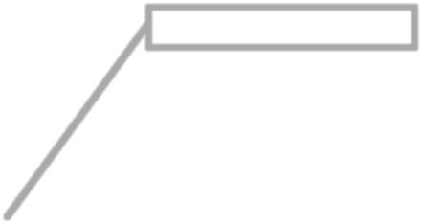
Arachnoid granulation

Slide 51
Factors of CSF flow
Pulsation of the cerebral & spinal arteries
Movements of the vertebral column
Respiration & coughing
Changing of the positions

Slide 52
What CSF does?

Slide 53
Blood-Brain-Barrier

Slide 54
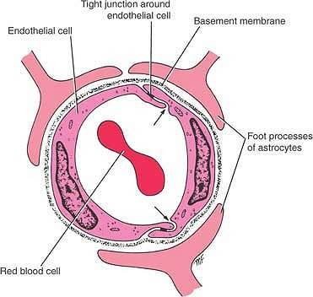

Slide 55
Blood-CSF-Barrier

Slide 56
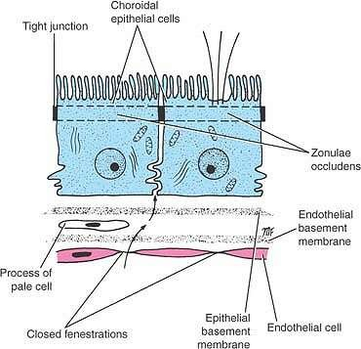

Slide 57
Clinical Notes

Slide 58
Papilledema
The optic nerves are surrounded by sheaths derived from the pia mater, arachnoid mater, and dura mater. There is an extension of the intracranial subarachnoid space forward around the optic nerve to the back of the eyeball.

Slide 59
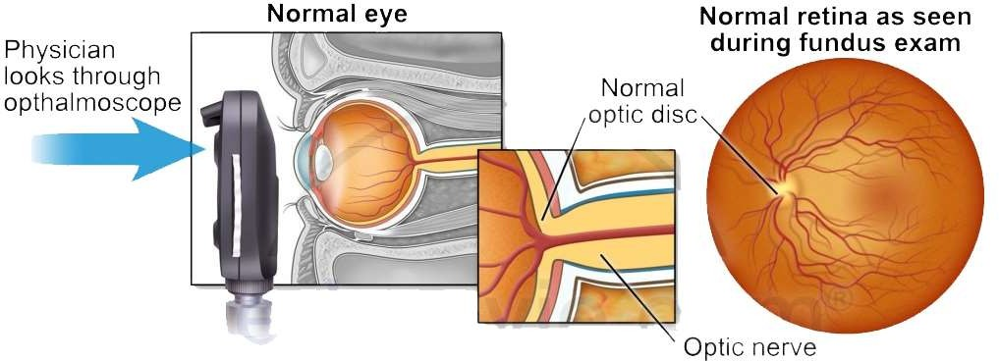

Slide 60
A rise of cerebrospinal fluid pressure caused by an intracranial tumor will compress the thin walls of the retinal vein as it crosses the extension of the subarachnoid space to enter the optic nerve.
This will result in congestion of the retinal vein, bulging forward of the optic disc, and edema of the disc; the last condition is referred to as papilledema.

Slide 61
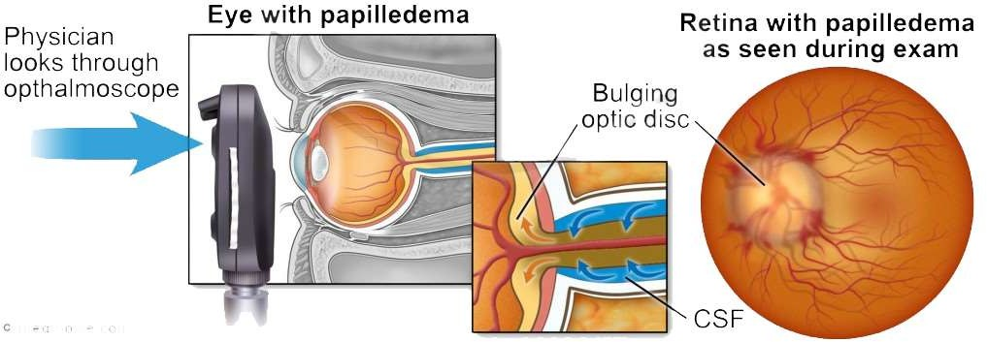

Slide 62
Hydrocephalus
Hydrocephalus is an abnormal increase in the volume of the cerebrospinal fluid within the skull.

Slide 63
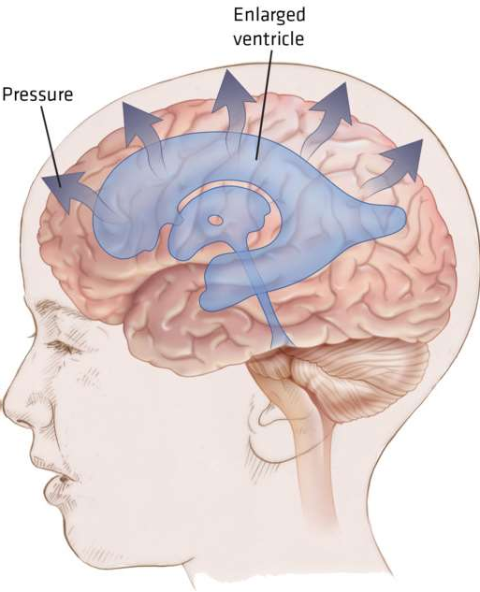

Slide 64
Causes can be:
Blockage of the circulation of cerebrospinal fluid
Diminished absorption of cerebrospinal fluid
Excessive formation of cerebrospinal fluid

Slide 65
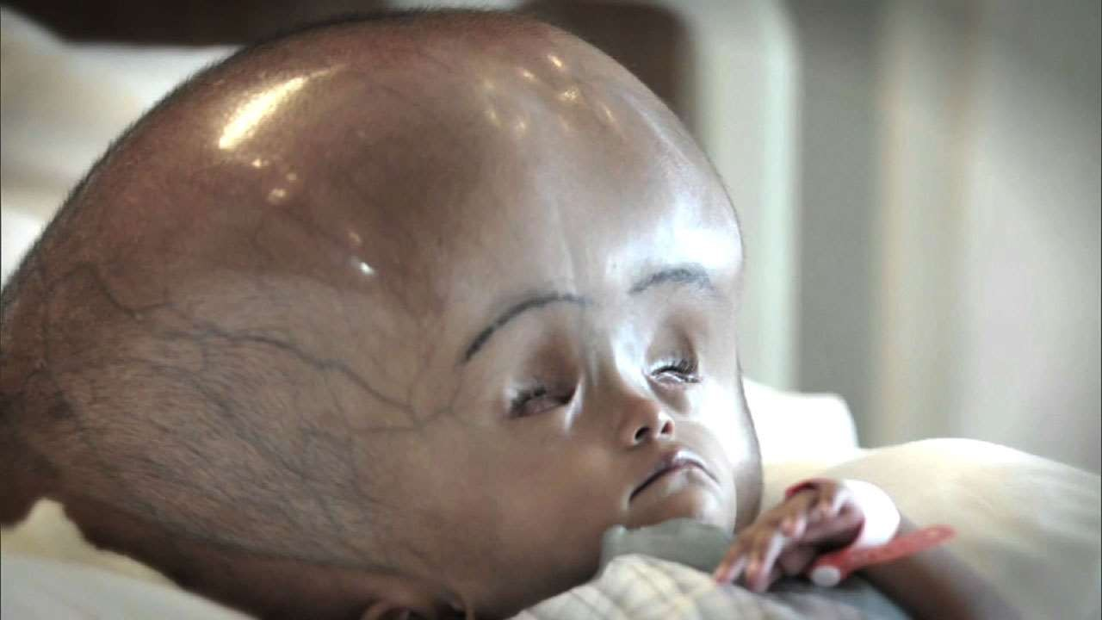

Slide 66
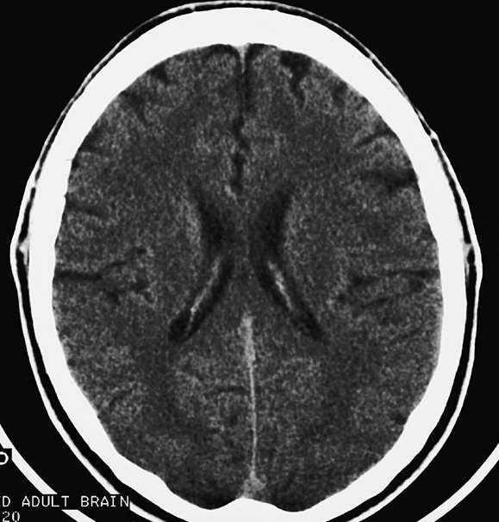
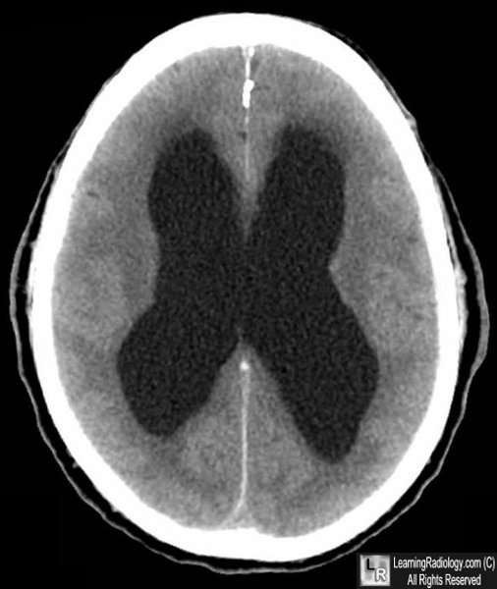

Slide 67
Diseases involving CFS
Meningitis
Blockage of the subarachnoid space in the vertebral canal
Tumors of the fourth ventricle
Kernicterus

Slide 68
Lumbar Puncture

Slide 69
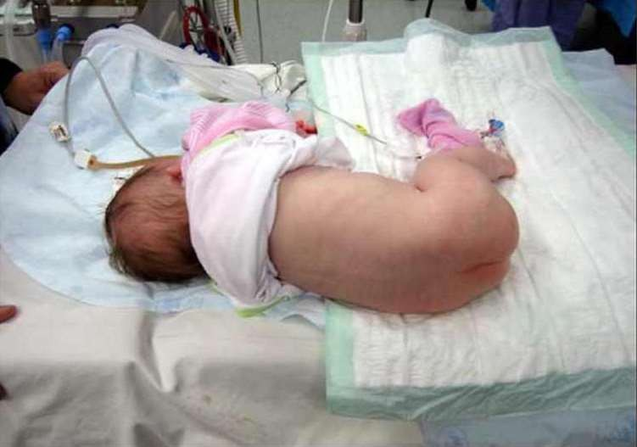

Slide 70
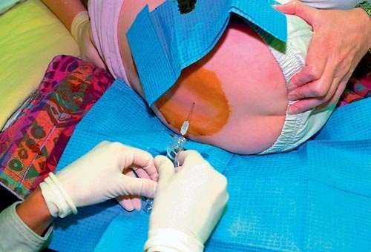

Slide 71
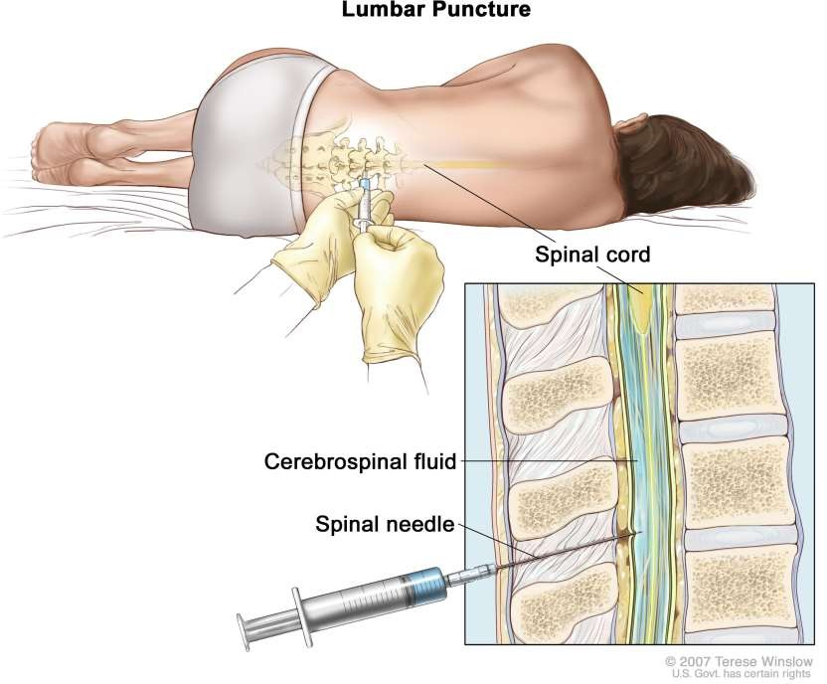

Slide 72
Layers punctured
Skin
Fat
Supraspinous ligament
Interspinous ligament
Between or through the ligamenta flava
Epidural fat and veins
Dura
Subdural space
Arachnoid

Slide 73
Thank You

